Slide 1
Neural network models for object recognition
By Courtney Sommerville
Notes:
Hi, this is my powerpoint on neural network models for object recognition by Courtney Sommerville. So lets begin.

Slide 2
Introduction
What are neural networks and their structure?
What is Pattern recognition in neural networks?
What are the applications of neural networks?
What is the impact of big data?
What is the importance of understanding neural networks?
Notes:
So before we begin anywhere lets answer a few questions on neural networks.
So first what are neural networks? Neural networks are models, and these models are inspired by the human brain, it processes information through interconnected nodes. These nodes are what transmit and process data effectively.
What is pattern recognition in neural networks? So Neural networks learn to recognise patterns and from data inputs they then use this to make decisions and this enhances their utility.
What are the applications of neural networks? Neural networks commonly used in image recognition but can also be used in natural language processing and various other applications.
What is the impact of big data? These days with the huge rise in big data it has accelerated the adoption and development for neural networks, these networks can be trained when using large datasets to help with identifying features and it has a high accuracy.
What is the importance of understanding neural networks? Understanding neural networks is important because to be able to grasp at least the basics is crucial for understanding and using the data, it is also crucial for comprehending their role in object recognition.

Slide 3
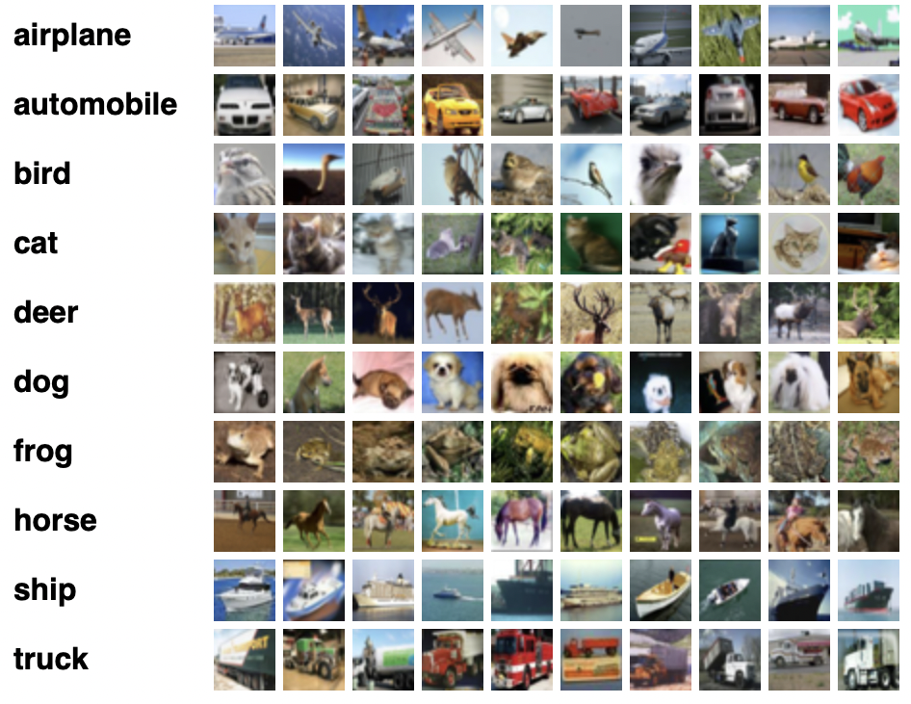
CIFAR-10 Dataset
3 people collected the CIFAR-10 dataset in 2009.
It contains 60000 images.
There are 10 classes.
The images are 32 x 32 pixels.
Notes:
In 2009 the CIFAR-10 dataset was collected by 3 people called Alex krizhevsky, Vinod Nair and Geoffrey Hinton. This data set contains 60,000 images and the images are 32 x 32 pixels. There are 3 RGB colours and there are 10 classess for example airplane automobile bird car deer dog frog horse ship and truck and each containing 6000 images.

Slide 4
Data Preprocessing
Data Splitting
The data is split into three datasets, training, test and validation.
The sets are used for different tasks, the training set is used to train, the test set is to provide unbiased evaluations and the validation set is used to fine tune models.
Notes:
The data is split into three datasets, these are training, test and validation, within these datasets the training set contains 40000 images, while both the test and validation set contain 10000 images.
The training set is used to train the model, this allows it to learn from a range of examples.
The test set is used to provide an unbiased evaluation and it helps to presents the real world in terms of its application and its effectiveness towards the model.
The validation set is used to fine tune the model parameters and also to help prevent overfitting, it also acts as a check during training.

Slide 5
Data preprocessing
Normalisation
What is the purpose?
What is the method?
What is the impact?
Notes:
Data preprocessing, normalisation. So what is the purpose? The purpose of the normalisation process is done to adjust the pixel values, this ensures the images range from 0 to 1 rather than 0 to 225.
This moves us on to what is the method? The method is done by dividing each pixel by 225 it changes the scale from 0, 255 to 0, 1.
And finally what is the impact? The impact this has is it helps to reduce model sensitivity therefore speeds up learning, as the neural network process input uses small weight values and if they are large values it disrupts or slows down the learning process, this is why we need to get the values to a smaller scale.

Slide 6
Data preprocessing
One hot encoding
What is the purpose?
What is the method?
What is the impact?
Notes:
Data preprocessing, one hot encoding. What is the purpose?
The purpose of this is to be able to turn categorical class labels into a binary matrix representation. In this case it turns a single integer label into a 10 element binary vector. In this index corresponding to the class label is set to 1 and all the others are set to 0.
This moves us onto what is the method? The method is done by converting the class labels into a binary vector with all the zeros except 1 which is located at the index of a class label.
The impact this has is it allows the training and evaluation metrics to become more interpretable by transforming the labels into a format that is more suitable for this classification task.

Slide 7
Model training
Artificial neural networks
What is a ANN?
What makes up ANN?
How does ANN work?
Notes:
Model training, artificial neural networks.
What is a ANN?
So when it comes to artificial neural networks also known as ANN these are models that resemble the structure and function of biological neural networks like in the human brain. They work in the same way.
What makes up ANN?
A ANN is made up of connected nodes which are called artificial neurons and these are connected by what’s called edges, and these edges resemble synapses.
How does the ANN work?
After each neutron receives a signal from connected neurons it then processes them to send a signal to other connected neurons. The output of each of these neurons is computed by non-linear function and this is from the sum of its inputs and these are called the activations functions. To determine the strength of each signal is depends on weight and the weight adjusts throughout the learning process.

Slide 8
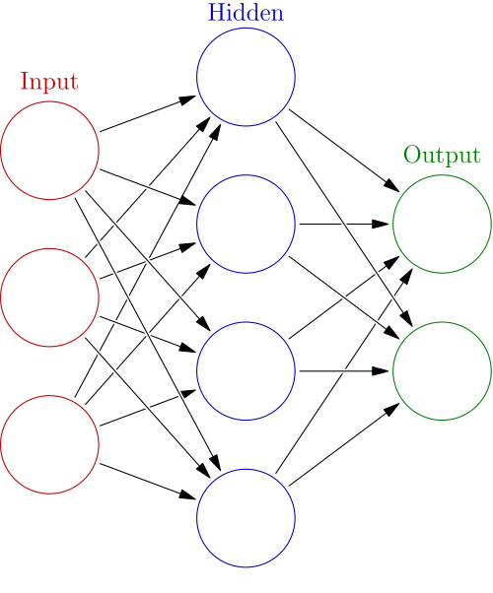
Understanding the mechanics of Neural Networks
Model training
Artificial Neural Networks
Input layer
Hidden layers
Neuron activation
Backpropagotion
Output layer
Notes:
So to understand the mechanics of neural networks we must understand the different layers.
A typical neural network has three layers, the input layer, the hidden layer and the output layer as shown in the image above. However if a network has at least two hidden layers it is usually called a deep neural network.
The first layer is the input layer, this layer receives the raw data and is therefore the starting point for processing.
The second layer is the hidden layers, this layer processes the data using weights and activation functions, this helps to enable the network to learn complex platforms. The next layer is neuron activation, each neuron calculates a weighted sum of the input and it applies an activation function to determine the output. Next is backpropagotion, this is where the weight is adjusted to minimise predication error, and the final layer is the output layer, it provides the final predictions or classifications and this is based on the processed data from the hidden layers.

Slide 9
Model Training
Convolution Neural Networks
What’s the purpose of the convolution neural network?
What does CNN consists of?
input (images)
convolution (applying filters, this creates feature maps)
rectified linear unit (this is to increase the images non-linearity and helps to improve the feature extraction)
pooling (this is to reduce the spatial size of the feature map, and an example of this could be max pooling)
fully connected (this takes in a input volume, and it outputs the N-dimentional vector. The N is the number of classes being scored in the classifier)
output layer
Notes:
What’s the purpose of the convolution neural network?
Also known as CNN the convolution neural network was engineers to be able to automatically and adaptively learn multiple things at once and this can include features from low level details all the up to high level patterning.
What does CNN consist of?
CNN consists of different layers, these layers include input, convolution, rectified linear unit, pooling, fully connected and finally output layer. These layers all make up the CNN.
The input layer consists of images, convolution consists of applying filters and this creates feature maps, the rectified linear unit is to increase the images non-linearity and helps to improve the feature extraction, pooling is to help reduce the spatial size of the feature map, and fully connected is taking in a input volume and it outputs the N-dimentional vector where N is the number of classes being scored in the classifier, finally finishing with the output layer.

Slide 10
Model Training
Why do we use CNNs for the CIFAR-10 dataset?
It has preservation of spatial hierarchy.
It has paremeter sharing and efficiency.
It has depth utilisation and efficiency.
It also has adaptability to image data.
Notes:
Why do we use CNNs for the CIFAR-10 dataset?
We use it for multiple reasons and these reasons can be because it has preservation of spatial hierarchy. It also has a parameter sharing and efficiency. It has depth utilisation and efficiency and it also has adaptability to image data. All of these things making it very useful for the dataset.

Slide 11
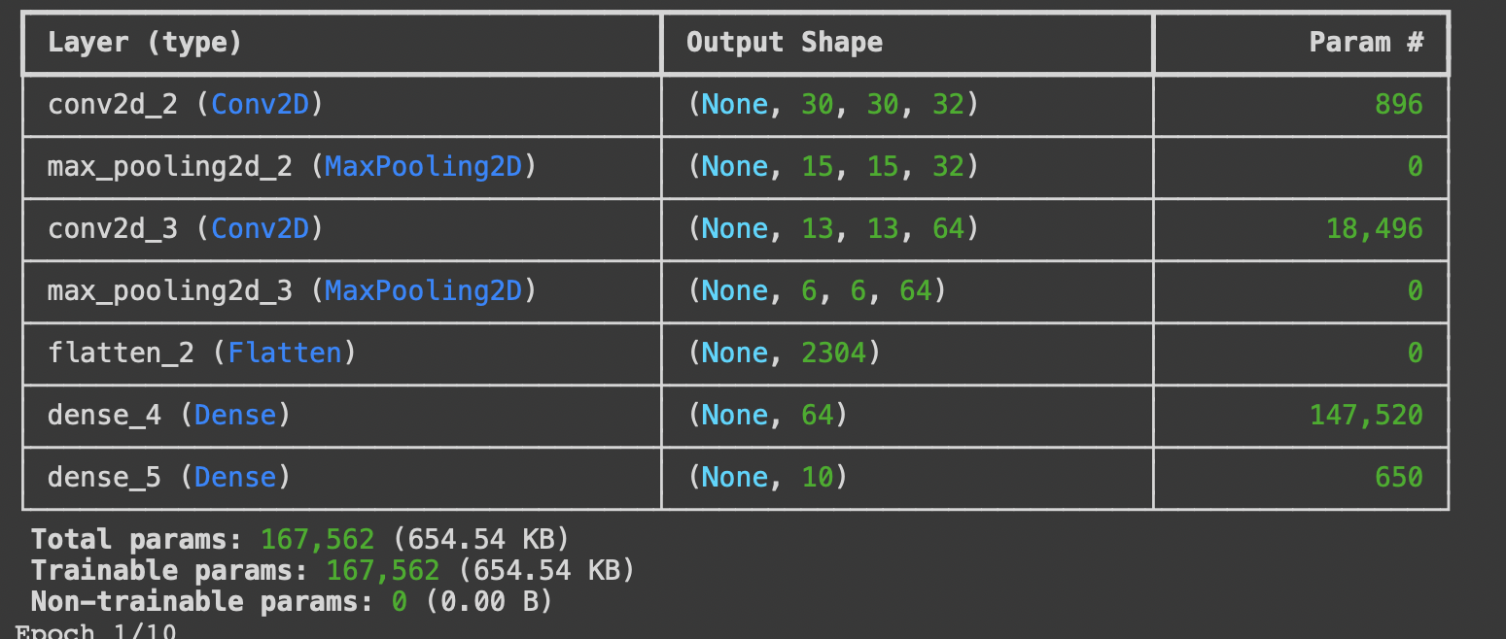
Model 1 Architecture
Notes:
So from model 1 architecture we can see the total parameter is 167,562.
We can also see the initial layer consists of conv2D with. 32 filters and these are 3x3 and also maxpooling2D.
Increasing complexety of conv2D with increasing numbers of filters at 64 followed by maxpooling2D again.
Feature flattening consists of flattening the layers to convert the 2D feature to a 1D feature which is needed to fully connect the layers.
The fully connected layers with a dense layer of 64 neurons to be able to process the flattened feature.
Output layer with a dense layer of 10 neurons .

Slide 12
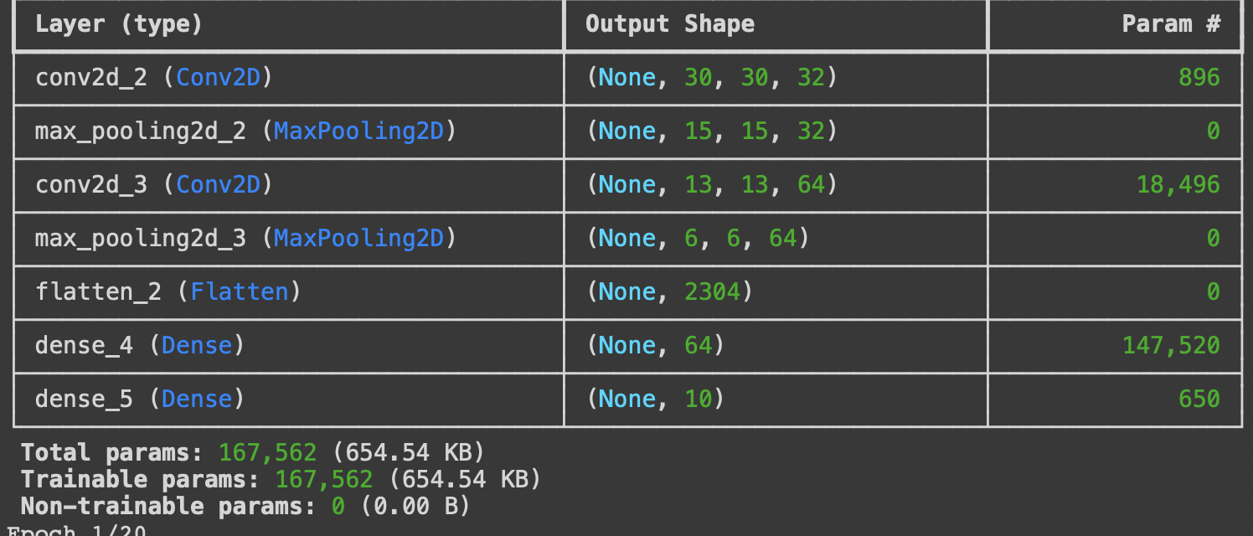
Model 2 Architecture
Notes:
Model 2 architecture, the values are no different due to the low number of epochs. There is no difference between model 1 and model 2.

Slide 13
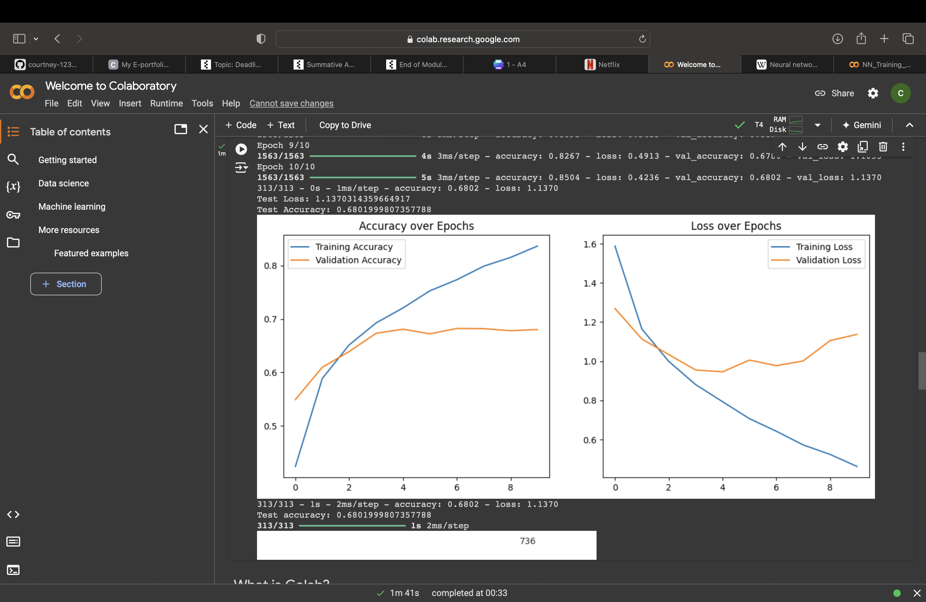
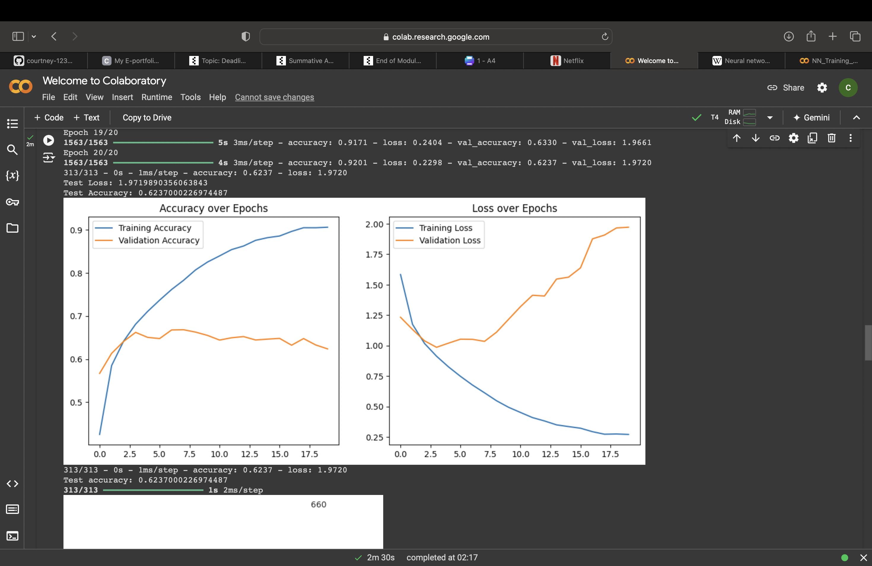
Model 1 and 2 Performance
Model 2
Model 1
Notes:
So as we can see from model 1 the Epochs = 10, and the batch size is 64, so the model is overfitting, there is a big gap between training and validation accuracy. For the accuracy over epochs both the training and validation accuracy increases but the training accuracy increases higher and faster than the validation accuracy. For the loss over epochs the training loss drops of suddenly where as the validation loss drops of slowly, goes back up a little and drops again before finally going back up slightly.
For model 2 the Epochs = 20, and the batch size is 64, meaning the model is overfitting, the model is learning from the noise rather than generalising it. For the accuracy over epochs the training accuracy jumps up quite quickly and very high, whereas the validation accuracy goes slightly up and down continuously along the line. For the loss over epochs the training loss drops suddenly and curves down where as the validation loss drops slightly before slowly climbing all the way up.

Slide 14

Model Evaluation
Classification report
Notes:
So as we can see from the classification report, the higher the epochs the higher the accuracy begins to climb up the graph.
Accuracy in blue climbs much higher than value accuracy in orange which seems to stay at a steady pace all the way along the graph only slightly rising.

Slide 15

Confusion Matrix
Notes:
So as we can see from the confusion matrix Cats are misclassified as dog and frog.
Also Cat seems to be a problematic class, causing a few problems.
There is high positive rates in frog, airplane and automobiles.
Rewrite this///////

Slide 16
Recent advancements in Neural Networks
Neural networks have advanced significantly recently.
Transfer learning reduces training time and improves accuracy.
Attention mechanisms enhance feature focus in images
New architectures like vision transformers are competitive
Unsupervised learning expands accessibility with limited data.
Object recognition accuracy has improved by over 30% in 5 years.
Notes:
So recent advancements in neural networks, they have advanced significantly within recent years. Transfer learning has reduced training time and to has improved accuracy. The attention mechanisms enhance feature focus in images. New architectures like vision transformers are competitive and unsupervised learning expands accessibility with limited data. With all this object recognition accuracy has improved by over 30% within the last 5 years. This is all fantastic work and is probably going to advance even more in the next coming years.

Slide 17
Recommendation and conclusion
Recommendation:
I recommend enhanced feature engineering.
Conclusion:
Challenges that can occur during training consist of overfitting and computational and time demands.
The effectiveness of CNNs in image recognition is good
Notes:
My recommendation is that I recommend enhanced feature engineering, I also recommend more algorithm tuning and also some more advanced techniques that include deeper layers to enable better capturing of subtler distinctions between the different classes.
The conclusion of this that challenges that can occur during training consist of overfitting and computational and time demands. Also the effectiveness of CNN in image recognition is considered good. But everything can be improved and it will become more advanced in the coming years.

Slide 18
References
Krizhevsky,A. (2009) CIFAR-10 and CIFAR-100 datasets. Available from: https://www.cs.toronto.edu/~kriz/cifar.html [accessed 05th October 2024].
Sewer,M. , Karim,M.R. , Pujari,P. (2018). Practical convolutional neural networks. Packt publishing. Available at: https://learning.oreilly.com/library/view/practical-convolutional-neural/9781788392303/ [ data accessed 07th October 2024].
Wikipedia. (2024). Neural network (machine learning). Available at: https://en.wikipedia.org/wiki/Neural_network_(machine_learning) [data accessed 19th October 2024].
Notes:
Thanks for watching.

